Slide 1
Observations of Change in One Family
Andrea M. Schara
The Learning Space
www.ideastoaction.wordpress.com
1

Slide 2
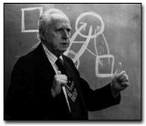
Murray Bowen M.D.
( 1913- 1990)
“The kind of people we are is determined largely by the character of our relationship with others.”
2

Slide 3
Family Interactions Influencing Behavior
Evolutionary mechanisms redistributing anxiety
In family systems we can observe the way people interact, influences the brain’s pathways
Two systems for perceiving and behaving:
Automatic - fast track thinking – Reactive based on past sensitivities to experiences.
Examples: make the problem person behave, your are to blame, stop, do this………
Slow track thinking - self regulate, stay separate…
3

Slide 4
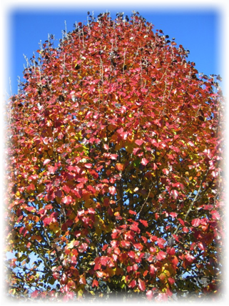
We see a Tree
But not the forest or the mechanism for growth.
4

Slide 5
Bowen Theory Assumption: The Family is a System/Unit
Anxiety is redistributed in a system.
One person absorbs more anxiety, or is more vulnerable:
This person has lost the ability to solve problems. Others or institutions begin to tell them what to do.
Automatic mechanisms manage anxiety:
Reactive behavior - give up self by fusing with the other, fight, run, blame others, go crazy, or get sick.
Define a self while staying connected to others.
5

Slide 6
Observe and then Develop a Learning Space with Others
Fearful interactions can be toned down by focusing on self, using humor and reversals to create a space for the other.
NeurCare, after conversations, allows for integration of both cognitive and physiological information.
3) Videotape interactions keeps observations as the main point of research on self and understanding others.
6

Slide 7
Functions of Symptoms in the Relationship System
Symptoms absorb anxiety, some do better and others become isolated.
Reduce anxiety by having calmer contact
Relationships can be thought of as people being on a fixed see saws.
Anxiety is seen in triangle movement...
7

Slide 8
Listening & Following or Be Out of Sync
How to be a separate self while holding others responsible, and without telling them what to do?
Use of paradoxical statements and reversals: Think outside the stimulus response world.
Holding people responsible.
“This is what I would do if I were you, which I am not, at lest not yet.”
Learn from mistakes have fun.
8

Slide 9
You can't control a whole damn family...
but you can control you,
and anytime you can control you,
the family is a healthier organism.
That is a reason to become a self.
The more you can become a self, the more to your advantage, and the families.
~ Murray Bowen, M.D.
9

Slide 10
Overview of Manic Depressive Diagnosis in Nuclear Family
Diagnosis correlated with the serious illness or deaths of significant family members.
1972-74 Maternal grandmother and mother died and I was divorced and both my brothers were diagnosed with manic depressive symptoms.
Problems seen on reflection:
cut off from the extended family
increasing anxiety in nuclear family
limited knowledge about family emotional process
10

Slide 11
One Small Forest- Family as a Unit
The Maloney- Maher Family
d.71
d.77
d.72
d.64
M.40 -S.49 & 52
AJM 1909-67
AWM, 1918-74
AMS 1941
AJM, Jr. 1950
WMM, 1943
11

Slide 12
The Mutigenerational Pattern
2005 Paternal Uncle Jimmy Maloney dies
April 2006 Uncle Jimmy’s birthday, Drew becomes manic
Family members panic and call me to do something!
12

Slide 13
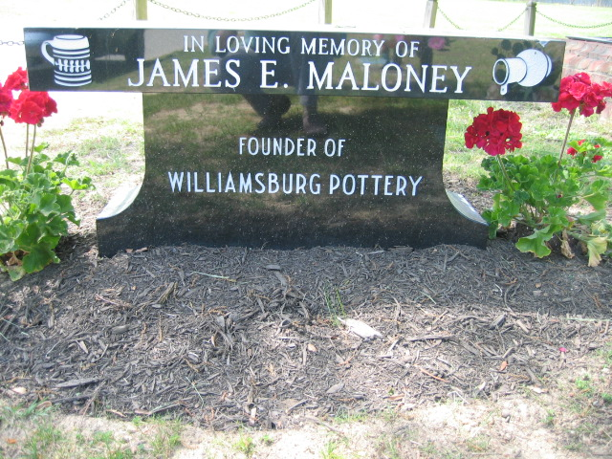
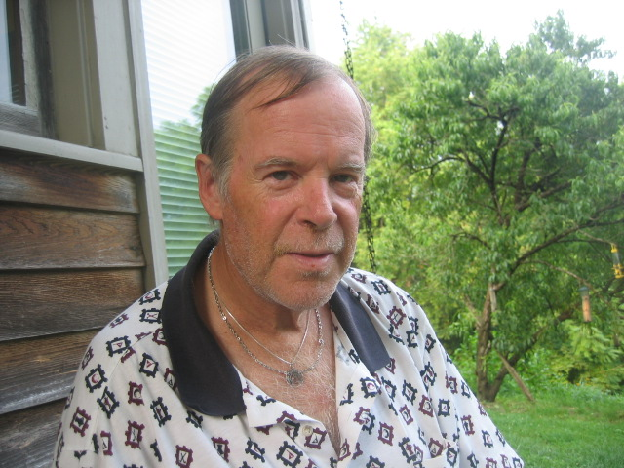
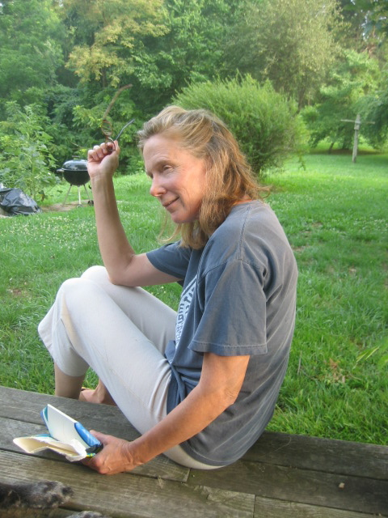
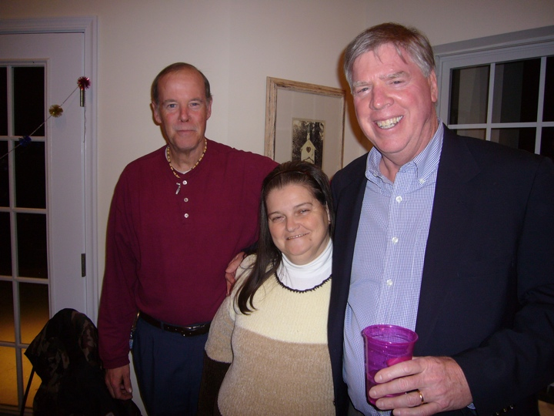
Generations
Father d. 67, Marie d.58,Leo d. 76 Betty d.78
Jimmy d. 05
Liz
13

Slide 14
Initial Strategy:
Contact family members to organize greater contact
Two first cousins volunteered to help.
Charles Crone was in Williamsburg and believed in the medical model. He took responsibility to take Drew to physicians. Drew was hospitalized May, 2006.
Liz Eitt offered her family farm as a meeting place for Drew, his wife Margie and me, where we could begin to understand how to better deal with one another.
14

Slide 15
Breaking Pattern of Isolation
Principle: 50/50 – You do something for me and I will do something for you.
Financial help for taking difficult action.
Move out of house, have teeth fixed, apply for disability,
We will buy you a trailer
Come to Liz’s farm follow the rules:
no smoking in the house, shower, exercise, NeuroCare
We will pay bills until you get disability.
15

Slide 16
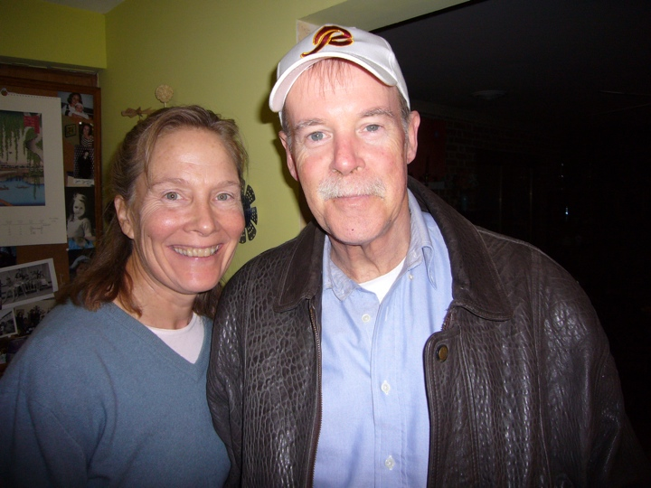

Slide 17
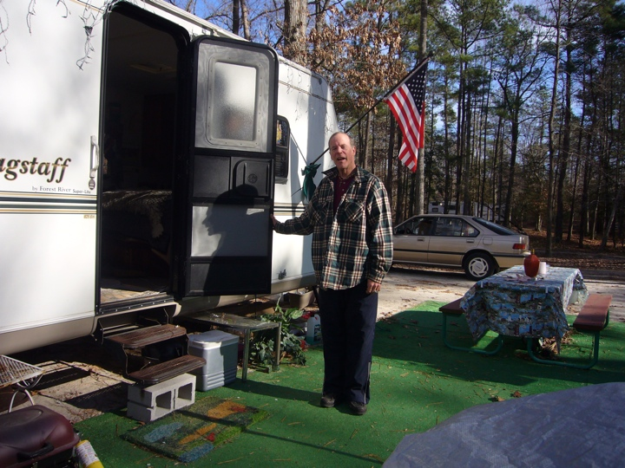

Slide 18
Breaking Patterns using NeuroCare
Neurofeedback training breaks up chaotic, old patterns in the brain.
Interrupt - Every 20 seconds: Alert - Relax
Feedback enables the brain to see its own functioning.
Brain see association between chaos or non-awareness and awareness and relaxation.
Brain itself seeks comfortable new patterns.
18

Slide 19
Pre Eastern State – 11 sessions 4 months - 2006
5/16 06, 5/17, 5/24, 5/25, 6/19, 6/20, 6/25, 7/14, 7/15, 8/15, 8/16
Initial drug treatment did not clear up his functioning.
Added Seroquel in June and his shaking began.
Hospitalized 3 times for 3 to 5 days.
Admitted to emergency rooms twice for drug reactions.
Eastern State Hospital - August till Oct 10,
Father died there 1967.
19

Slide 20
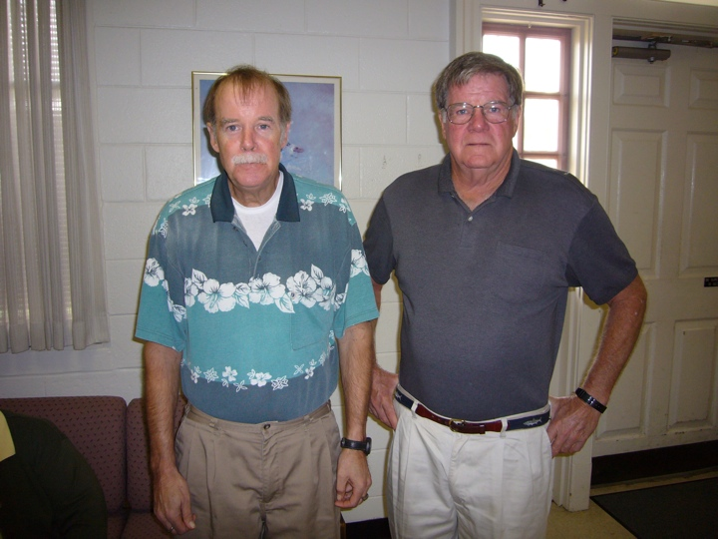
Butch visits his brother Drew
at Eastern State Hospital
August to October 2006
Lost 30 ponds- developed Parkinson's like symptoms

Slide 21
Stage two - Drew is Released from Eastern State
Letter to head of Eastern State
Noting possible drug issues
Drew’s father had died at Eastern State in 1967 when he was about Drew’s age
Developed aftercare plan by Liz and Mark
14 Zengar session after Drew stopped shaking for a moment involuntarily after the 10/12/06 session.
A profound turning point.
21

Slide 22
After Five Hospitalizations the Zen Farm Becomes a Learning Space
After 5 weeks in the state hospital Drew came to Zen farm. He had two short Neurofeedback sessions per day while others had one.
People surrounding my brother, including me, first had to learned to act as if we were not afraid for or of my brother.
Untrained people from the community were also involved.
22

Slide 23
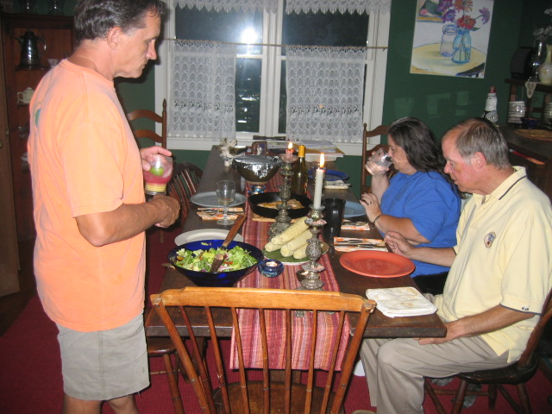
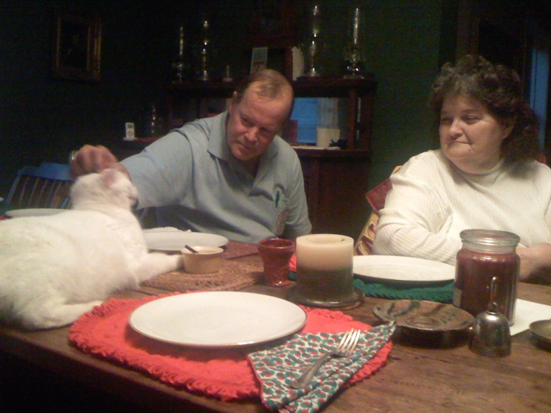
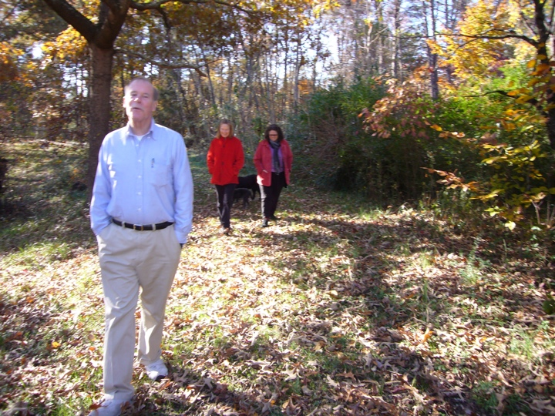
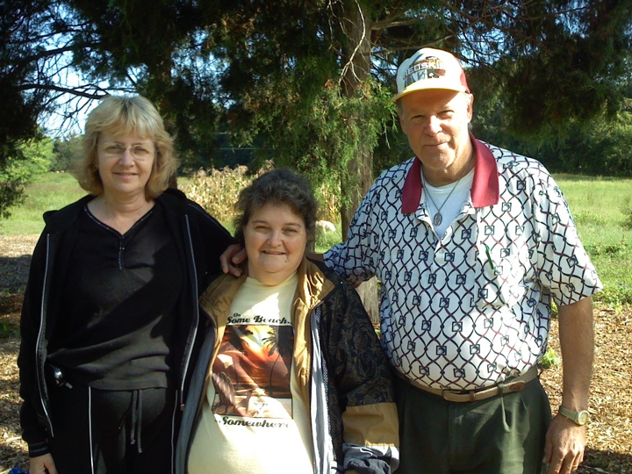
Establishing warmth when there has been confusion and distance.

Slide 24
Stage three – 22 sessions, one year and 3 months 2007 and 2008
Minor problems and consistent follow up
Total sessions: 47 sessions
May and June 2008 Margie: uterus removed and knee replacement surgery.
Drew lost his job at the golf course.
Drew began to work part time at his brothers T shirt shop.
24

Slide 25
AMS Neurofeedback Training:
2005- 16 session - Ten sessions before purchasing the equipment in August 2005 and 6 session on my equipment.
2006 -11 sessions
2007 – 18 sessions 7 sessions on my equipment and ten on others.
2008 – 16 session
total - 61 sessions
25

Slide 26
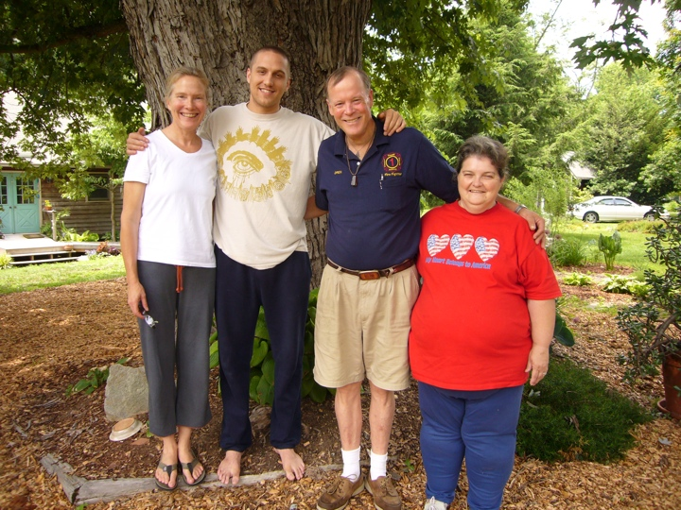

Slide 27
Evidence of Change
Shift in alliances and less symptom focus.
Drew became more functional his wife developed physical problems.
They have essentially remained free of emotional problems.
Drew remains on Deprocote, Lithium and Synthroid for a thyroid disorder
27

Slide 28
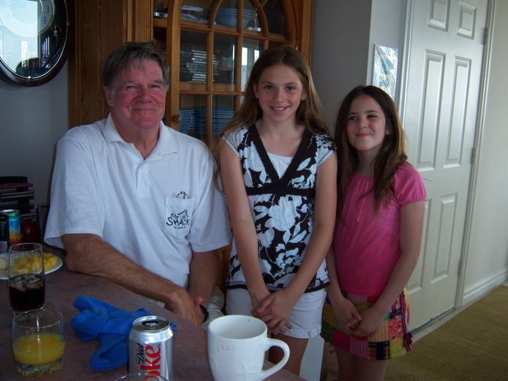
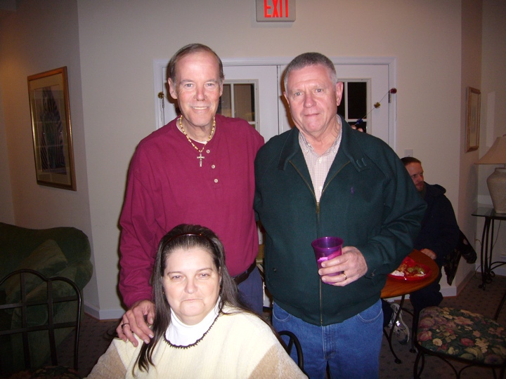
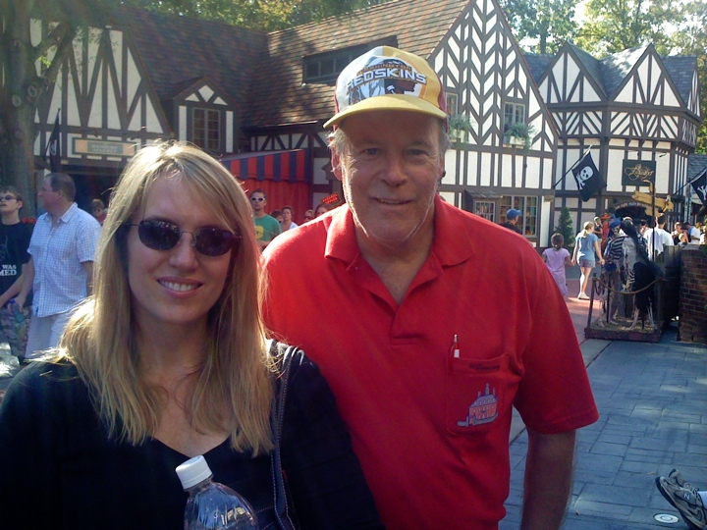
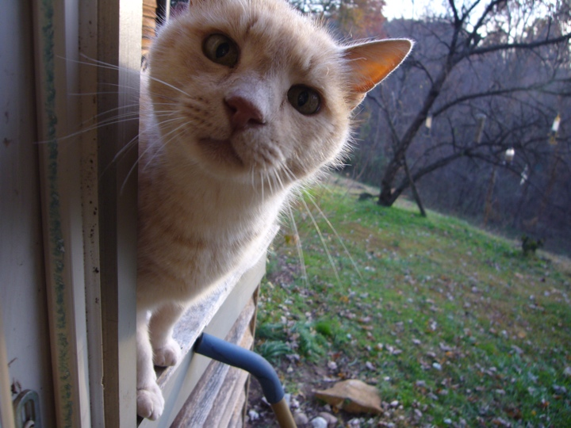
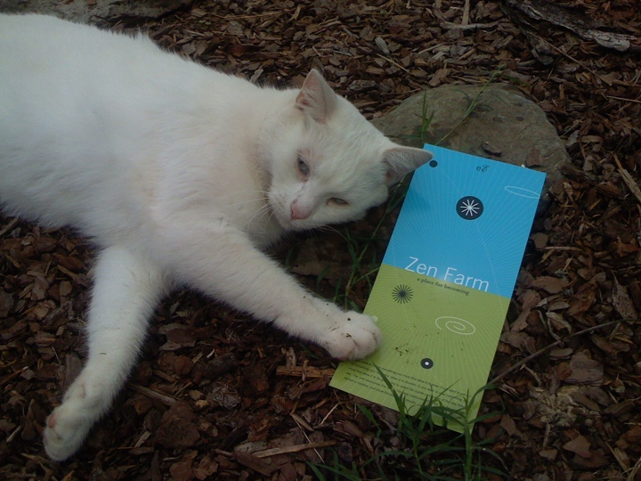
The more rigid patters in a family system, the more disturbed.
Flexibility allows for individuals to change one at a time.

Slide 29
Conclusions
I was willing to take many unpopular stands based on my experience and my interpretation of theory.
Neurofeedback enable people to interact calmly and to reflect on experiences.
People reported being able to see their impact on others and how anxiety functioned in relationships.
29

Slide 30
The Zen Farm Could be a Model
Weekends with family members
Three generational patterns
Emotional tone in interactions
Ongoing issues
Neurofeedback for everyone
Reduce anxiety, cognitive restructuring, be more in the moment and aware.
30

Slide 31
