Slide 1
Global qEEG Changes Associated With Non-frequency & Non-site Specific Neurofeedback Training
Edward B. O'Malley, PhD, D,ABSM
Director, Norwalk Hospital Sleep Disorders Center
Norwalk CT
Merlyn Hurd, PhD, BCIAC/EEG Fellow
New York, NY

Slide 2
Overview
Describe case study demographics
Provide global NF training concepts
Present case study NF training sample and trend data
Dr. Hurd will then discuss qEEG data from 2003-5

Slide 3
Case Study Demographics I
63 yo right-handed female
Dx chronic Lyme disease late 2002
Self-referred because
1) past 1.5 years of site/frequency-specific NF training protocols and hyperbaric sessions had not alleviated her SXs, including sleep problems
2) SPECT scan and MRI data consistent with compromised vasculature and white matter lesions, potentially being an impediment to specific brain driving protocols

Slide 4
Case Study Demographics II
Self-referred to me in part because of sleep disorders expertise and use of a comprehensive, adaptive targeting NF system
This “global” NF training took place over 6 months and included 30+ sessions
A qEEG performed in 2000 was within normal limits (data not shown)
Subsequent qEEGs were performed in 2003, 2004 and following global NF training 2005

Slide 5
Comprehensive And Adaptive NF Training Approach To Capture Changing EEG
16 target pair neighborhoods (boxes) overall, 8 each hemisphere
Increases or decreases in any box triggers interruption of the music
Sliding average of the median of the last data points collected measures changing rates of change (adaptive targeting)

Slide 6
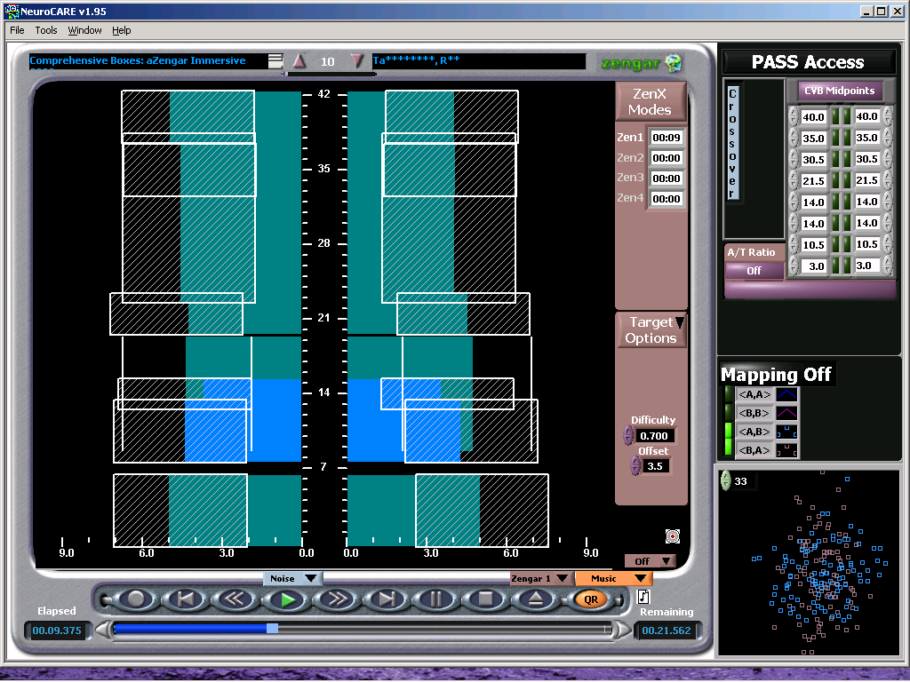
NeuroCARE® Neurofeedback Training System
16 target pair neighborhoods (boxes)
8-C3, 8-C4
All target boxes simultaneously active
CNS “decides” where to add or subtract energy

Slide 7
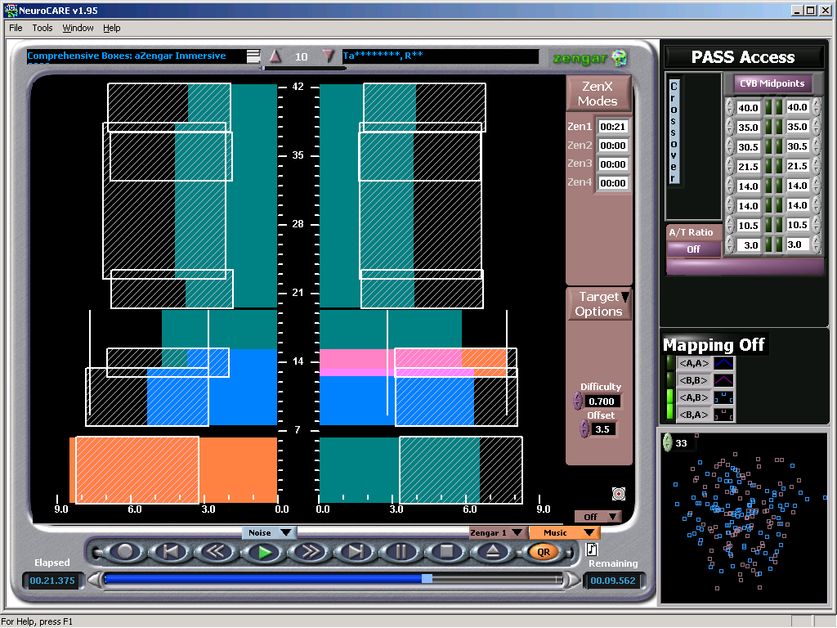
NeuroCARE® Neurofeedback Training System
2 target boxes triggering here indicated in orange
0-6 Hz intensity exceeds box in C3
SMR intensity diminished in C4

Slide 8
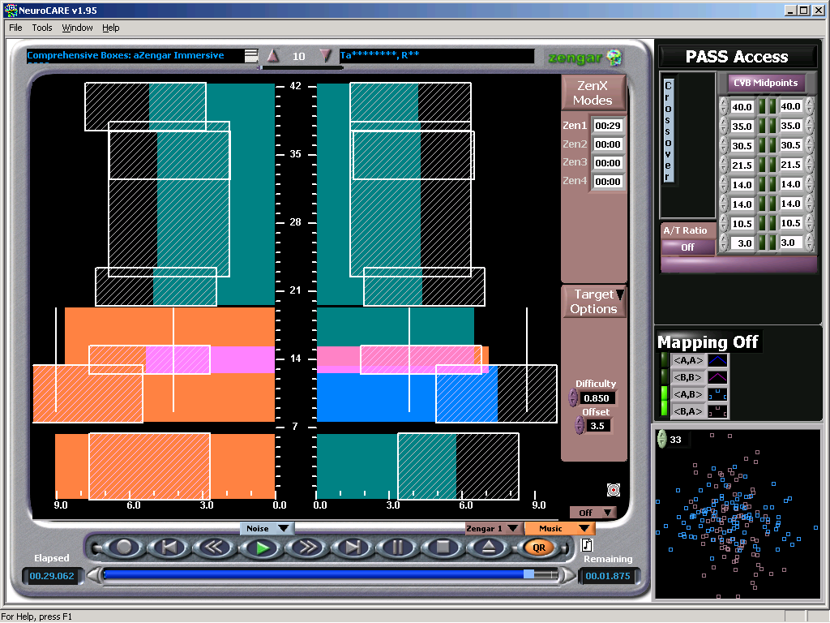
NeuroCARE® Neurofeedback Training System
5 target boxes triggering here (4 C3, 1 C4)
CNS “decides” where to add or subtract energy

Slide 9
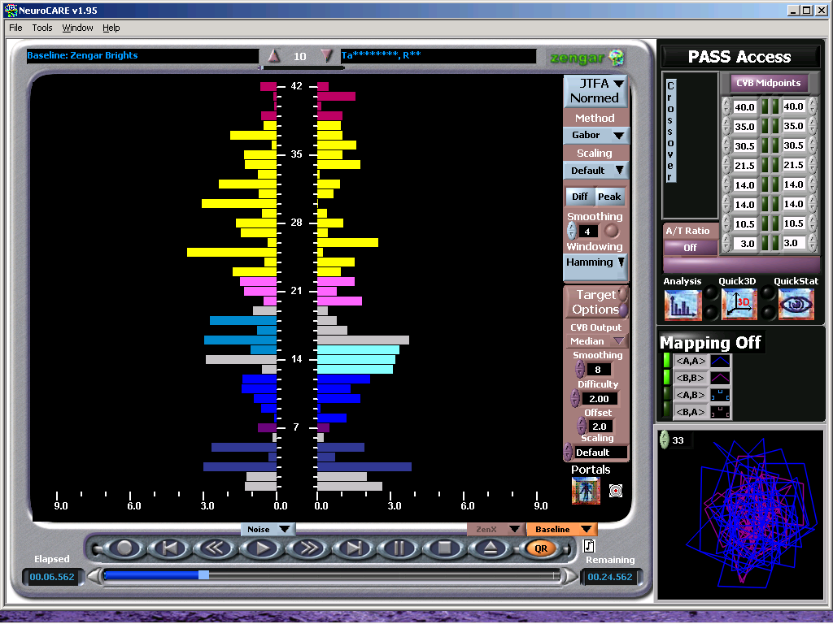
Baseline Pre-Post Training Session
30 second baseline data collected pre and post each training session
15s EO/15s EC

Slide 10
Auto Correlation Measure
Time-lag the individual moments of the collected data stream
Allows visualization of how similar those moments of the time-frequency analysis are to themselves

Slide 11
Cross Correlation Of Autocorrelation (CCAC) Measure
Correlate the two “time series” derived from the auto correlations
Visualize the similarity between each trajectory of those analyses
Maximally resilient and flexible systems will approach a gentle, logarithmic, flat correlation line across the spectral analysis

Slide 12
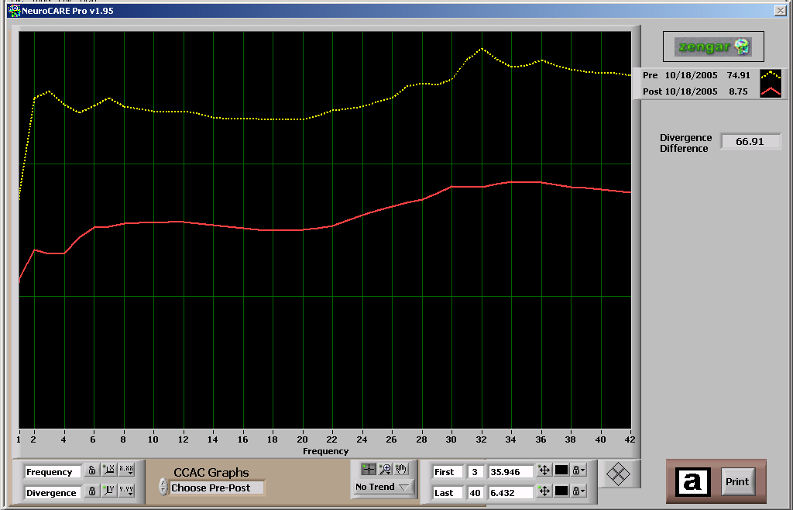
Baseline Pre-Post Training Session CCACs
Pre (yellow-dash) and Post (red-solid) Training Session Baselines
Autocorrelation of C3 crosscorrelated to autocorrelation of C4
Dramatic decrease in emergent variability seen pre to post baseline

Slide 13
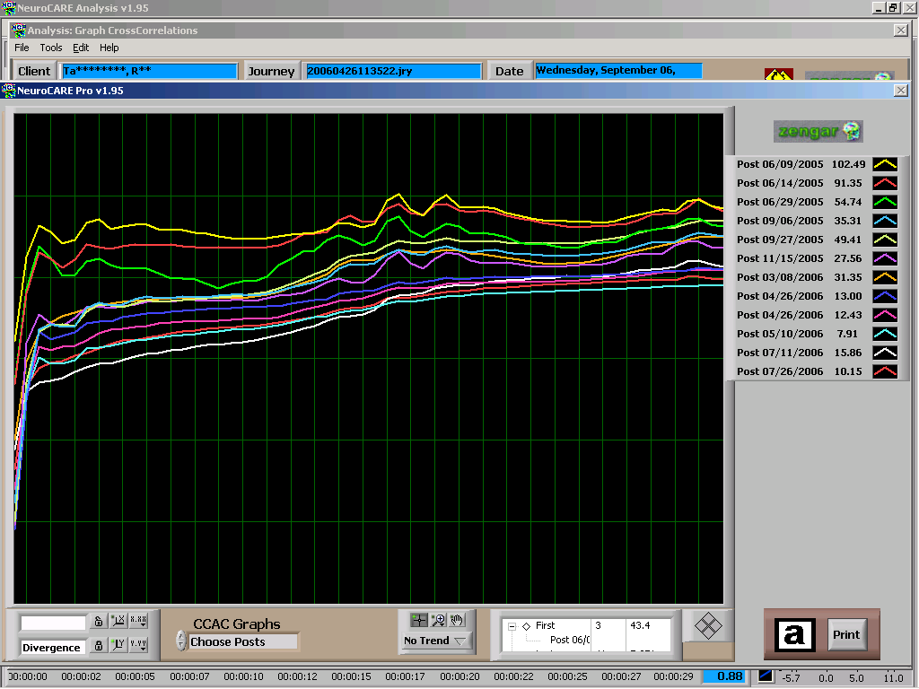
Baseline Post Training Session CCACs
Decrease in emergent variability seen over time
Some “wobble” seen = worsening before further improvement

Slide 14
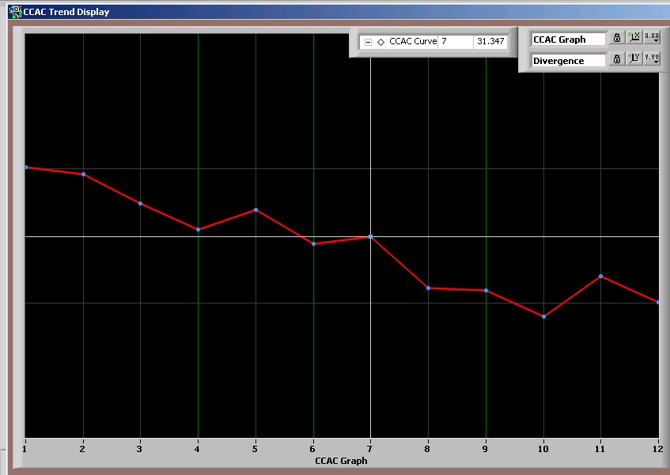
Baseline Post Session CCACs Trendline
(12 sessions)
Decreased divergence (CCAC) = increased stability
Reflects enhanced efficiency

Slide 15
Correlation Dimension: C*r
Measuring the diameter of the system and its trajectory
Increasing C*r over time indicates increased richness and complexity – can handle more information
Seizure is low dimensional, low complexity

Slide 16
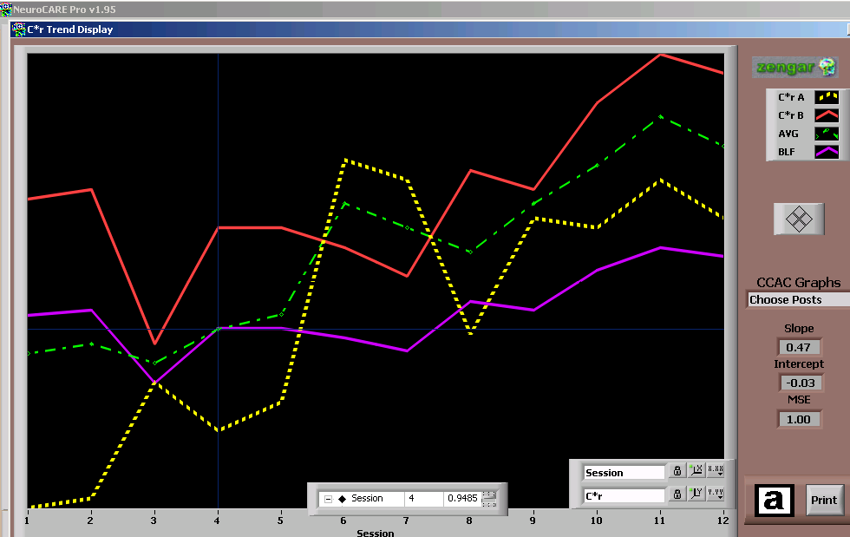
Baseline Post Session C*r Trendline
(12 sessions)
Increased C*r = increased complexity
Reflects increased information processing capacity

Slide 17
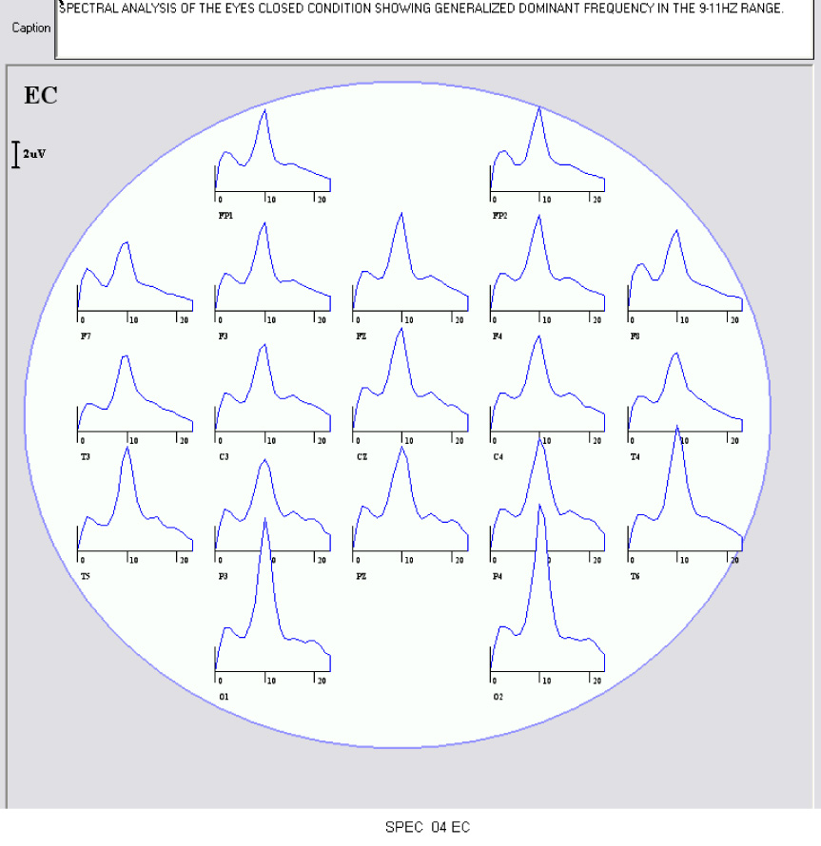
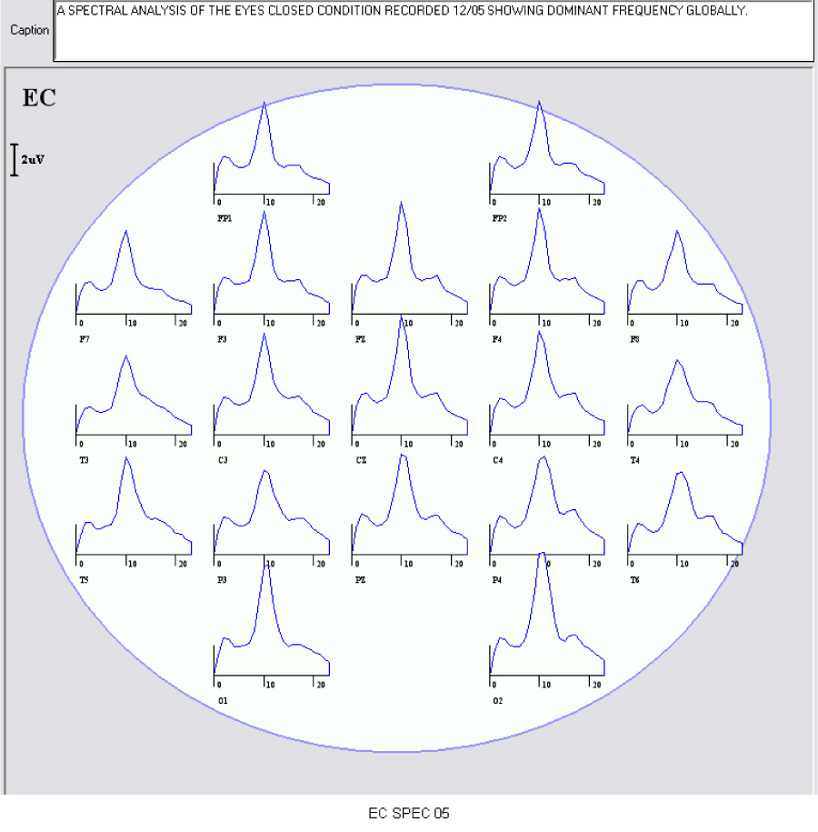
Spectral Analysis of the Eyes Closed Condition Generalized Dominant Frequency in the 9 - 11 Hz Range
2004
2005

Slide 18
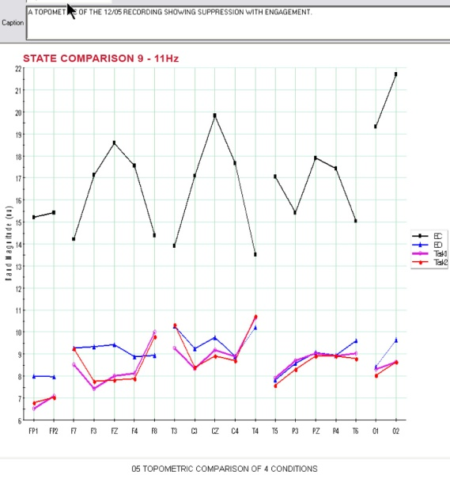
Topometric Comparison Four Conditions in 9 - 11 Hz Range
2003
2004
2005
Comparison of the four conditions shows the expected suppression with engagement. The analysis reveals the high magnitude in the frontal and central areas of the dominant frequency reaching into the 20 uv range.

Slide 19
Topometric Comparison Delta Range Over 3 Years
A Topometric analysis of the three recordings in 2003, 2004 and 2005 showing changes eyes closed in the delta range. The latest is closest to the norm.

Slide 20
Topometric Comparison Beta 1 (15-18 Hz) Range Over 3 Years
A Topometric analysis of 2003, 2004 and 2005 recordings in 15-18 Hz band showing elevation continues globally in comparison with the recording in 2003.

Slide 21
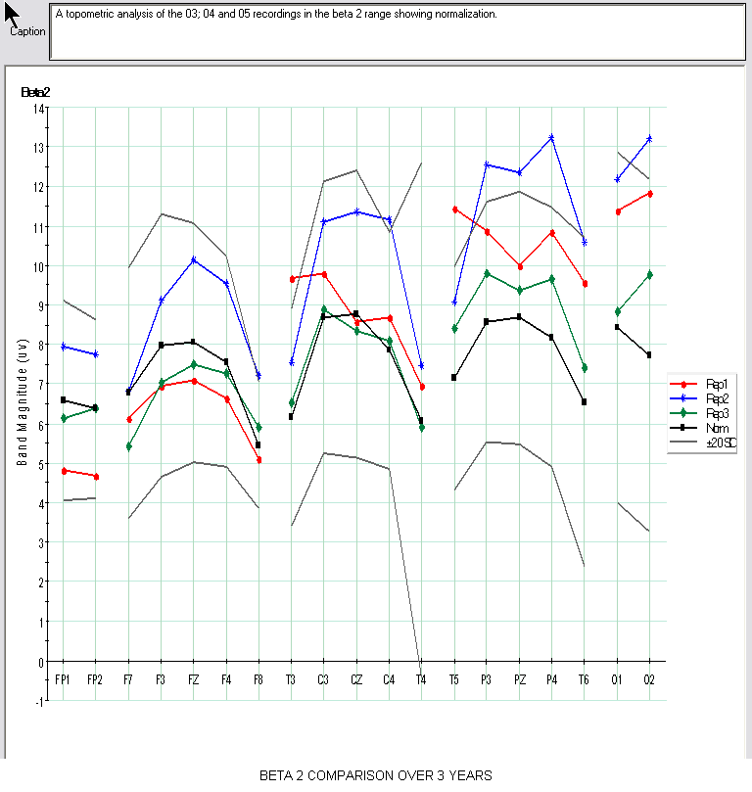
Topometric Comparison Beta 2 (18-23) Range Over 3 Years
A Topometric analysis of 2003, 2004 and 2005 recordings in the beta 2 range showing normalization

Slide 22
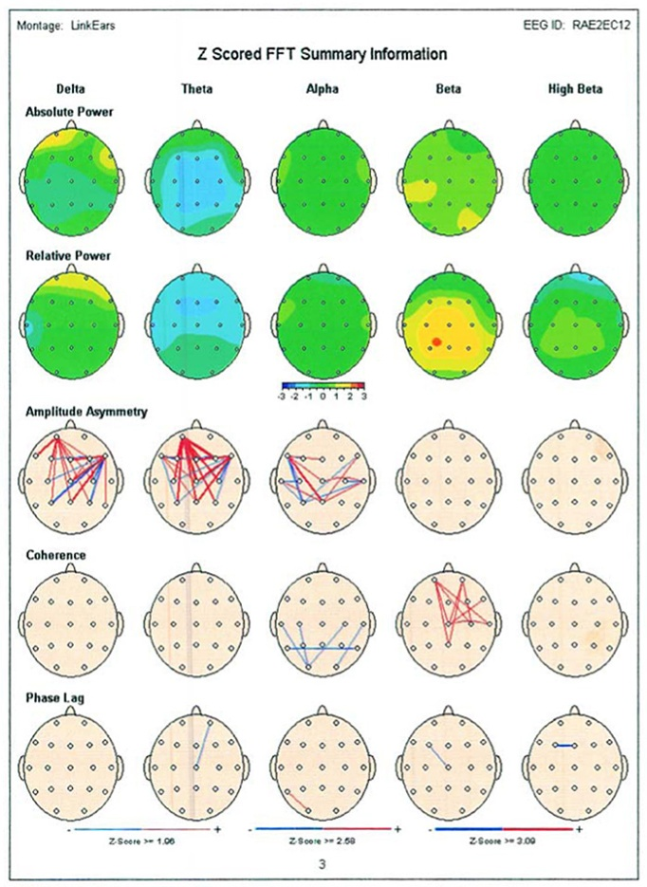
Z Scored FFT Summary Information Eyes Closed
2003
2004
2005

Slide 23
Summary
Minimal response to site/frequency specific brain driving protocols and hyperbaric TXs, and evidence of structural damage prompts different approach
Comprehensive and adaptive global NF training protocol successfully resolves SXs
Renormalization of qEEG maps confirms and supports functional improvement

Slide 24
Summary
Yale Lyme specialist attending neurologist confirms SX resolution and suggests that she “…not attend Lyme support group meetings because you will make everyone feel worse.”

